Slide 1
Digital Control System Analysis and Design
Chap. 1 Introduction
Chap. 2 Discrete Time Systems and the z-Transform
Chap. 3 Sampling and Reconstruction
Chap. 4 Open-Loop Discrete-Time Systems
Chap. 5 Closed-Loop Systems
Chap. 6 System Time-Response Characteristics
Chap. 7 Stability Analysis Techniques
Chap. 8 Digital Controller Design

Slide 2
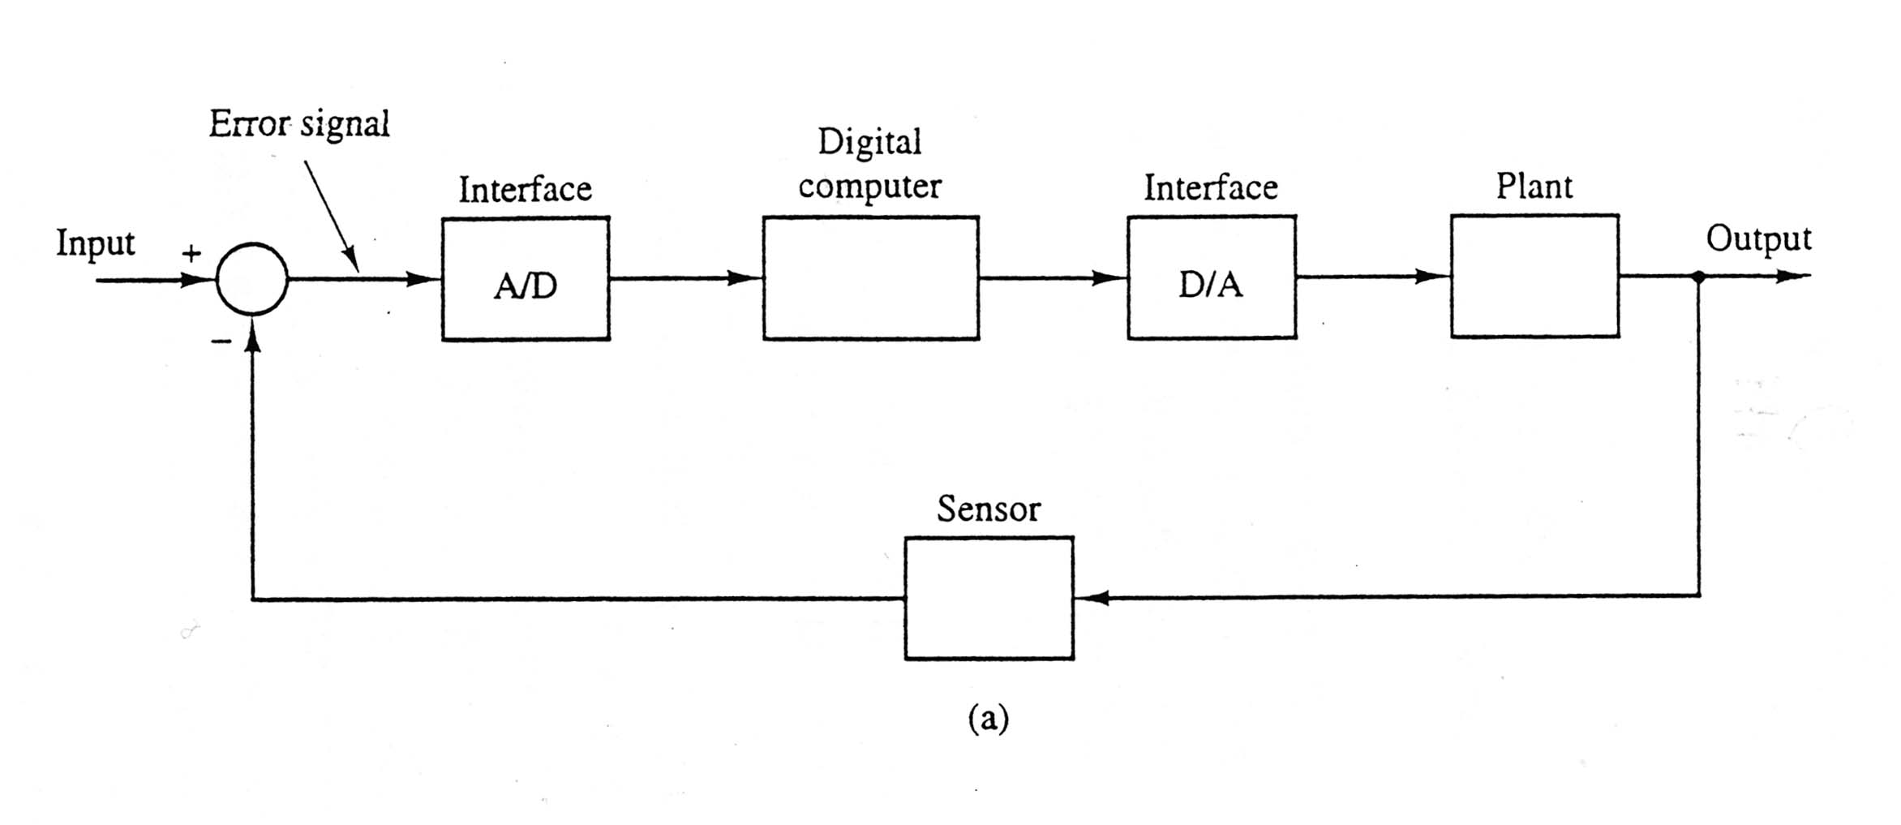
2.2 Discrete-Time Systems
CT models: Differential Eq., Laplace transform, state space, diagrams
DT models: Difference Eq., z-transform, state space, diagrams
e(t)
m(t)

Slide 3
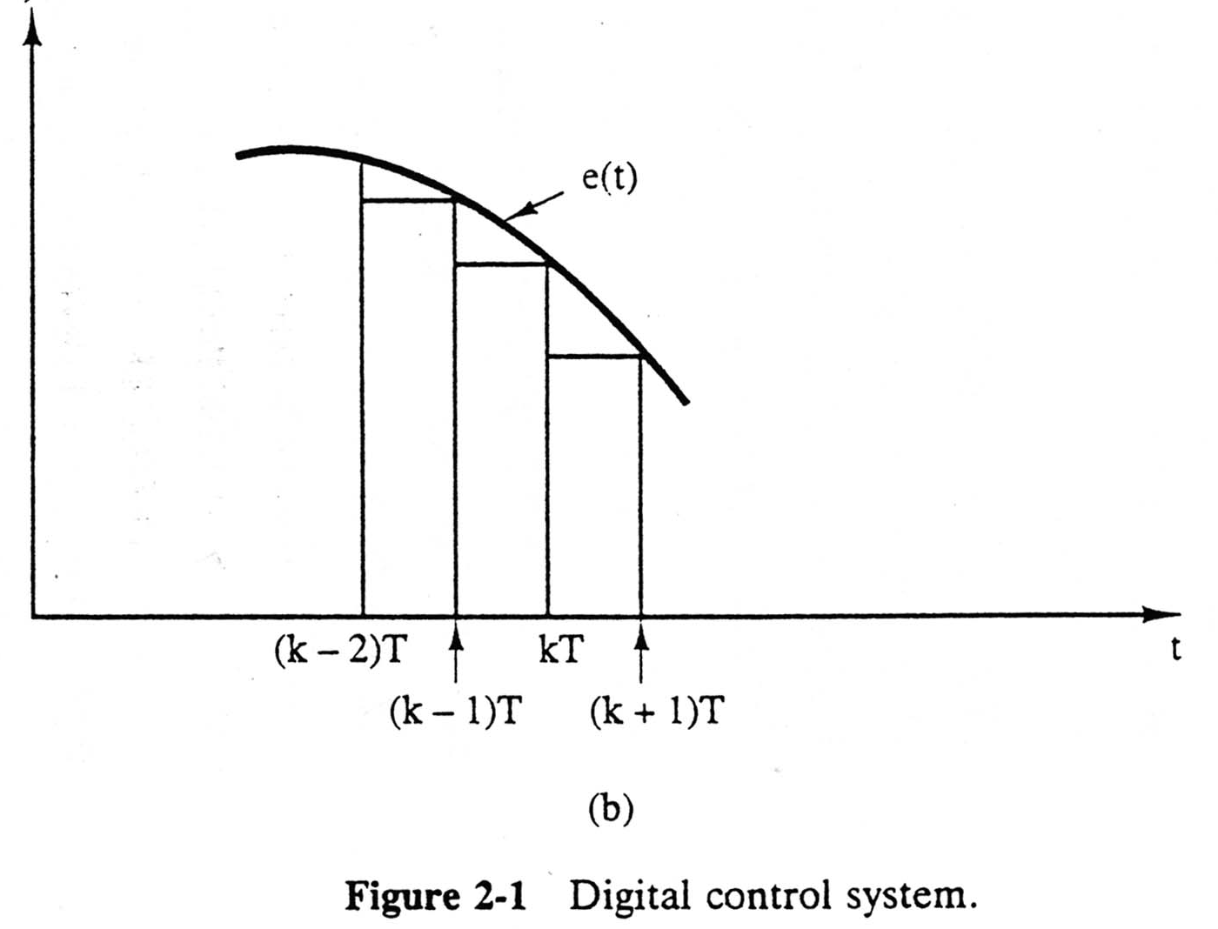
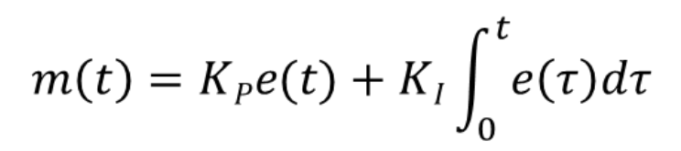
Assume a PI controller
Rectangular rule
Two approaches
  Analog design -> transform to digital (Ch11)
  Digital design (Ch3-Ch10)

Slide 4
Realization
Analog filter
  RC network with OPA
Digital filter (controller):
  1) T: sampling period
  2) n: order
  3) a_{i} and b_{i}: filter coefficients
Round-off (truncation) issue! (四捨五入)
Noise filtering required: differentiation in PID.
  PD: high-pass filter

Slide 5


2.3 Transform Methods
The z-transform is expressed by the transform pair
E(z) in (2-7) can be written in more compact notation as
(2.8)
Applied to a sequence!
The double-sided z-transform, sometimes called the generating function is defined as
生成函數
一種形式冪級數，其每一項的係數可以提供關於這個序列的信息。
(2.9)

Slide 6
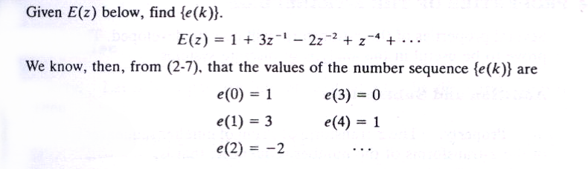
Example 2.1
反轉換 (inverse z-transform)

Slide 7
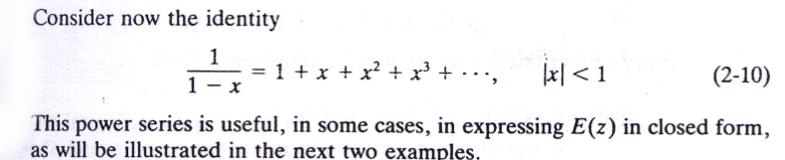
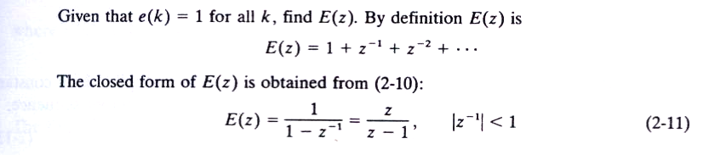
Example 2.2
等比級數
封閉型式
需標示，勿省略

Slide 8
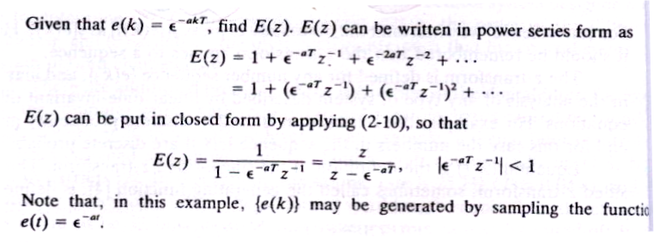
Example 2.3
取樣而得 (生成)

Slide 9
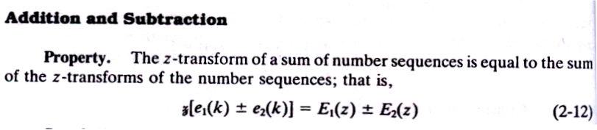
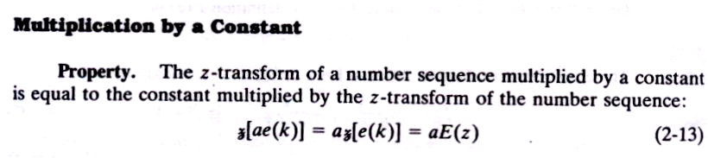
2.4 Properties of the z-Transform
1)
Linearity
2)
Homogeneity 同質性

Slide 10
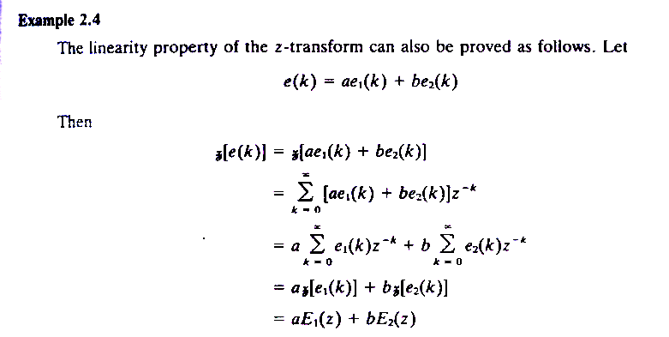
Example 2.4

Slide 11
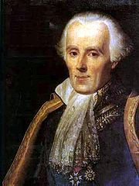
Pierre-Simon, marquis de Laplace
(23 March 1749 – 5 March 1827)
(START) Add Slides: Laplace’s Transform.
Newton of France

Slide 12
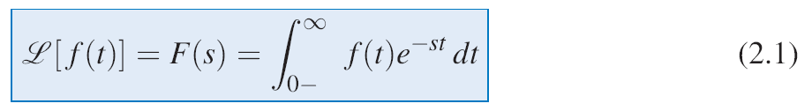
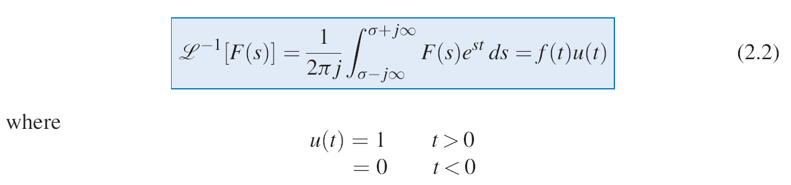
LAPLACE TRANSFORM REVIEW
z-Transform

Slide 13
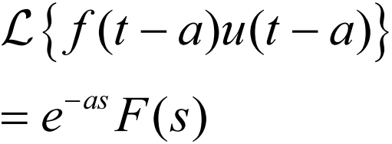
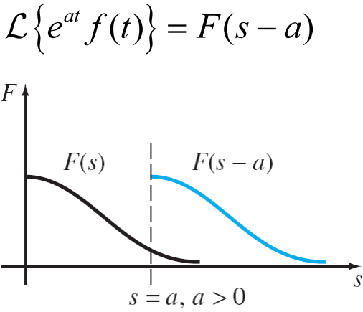
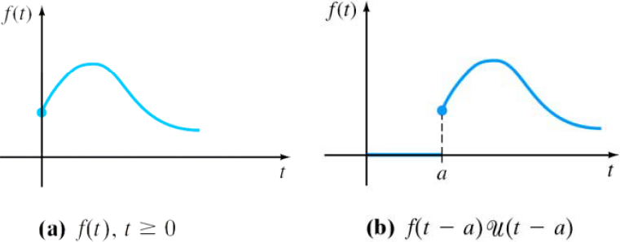
Quick Review
Time Shift: 2nd Translation Thm.
Frequency Shift: 1st Translation Thm.
Time delay

Slide 14
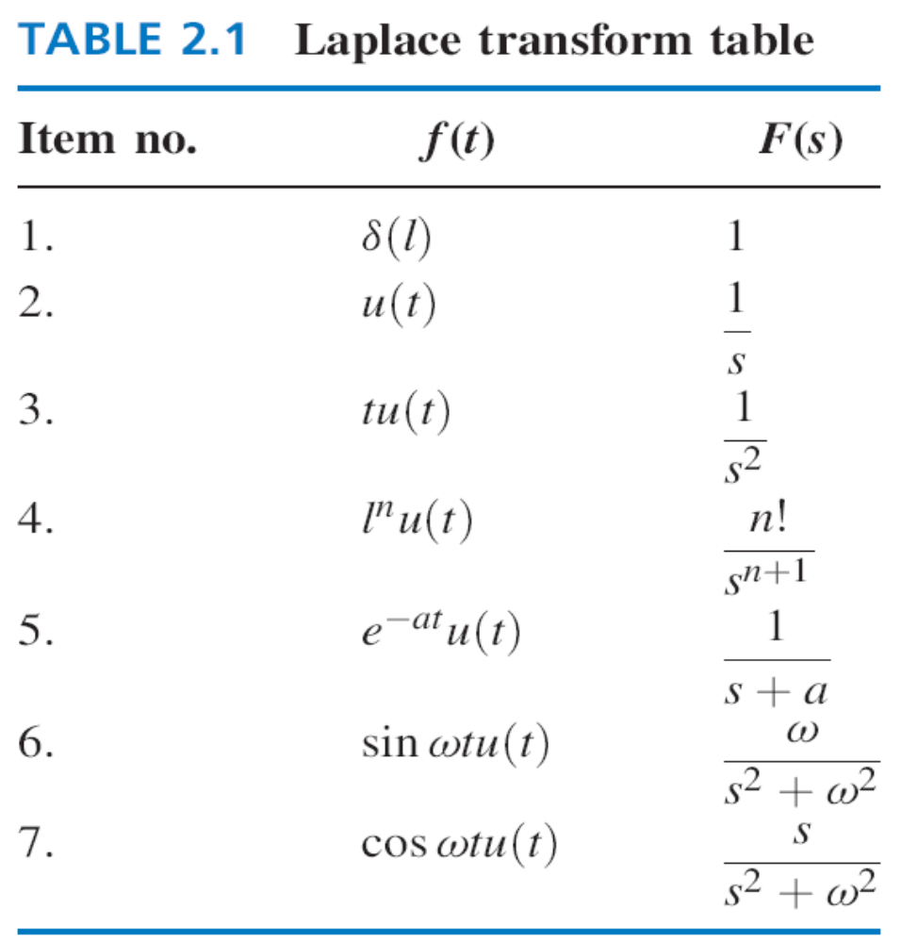

Slide 15
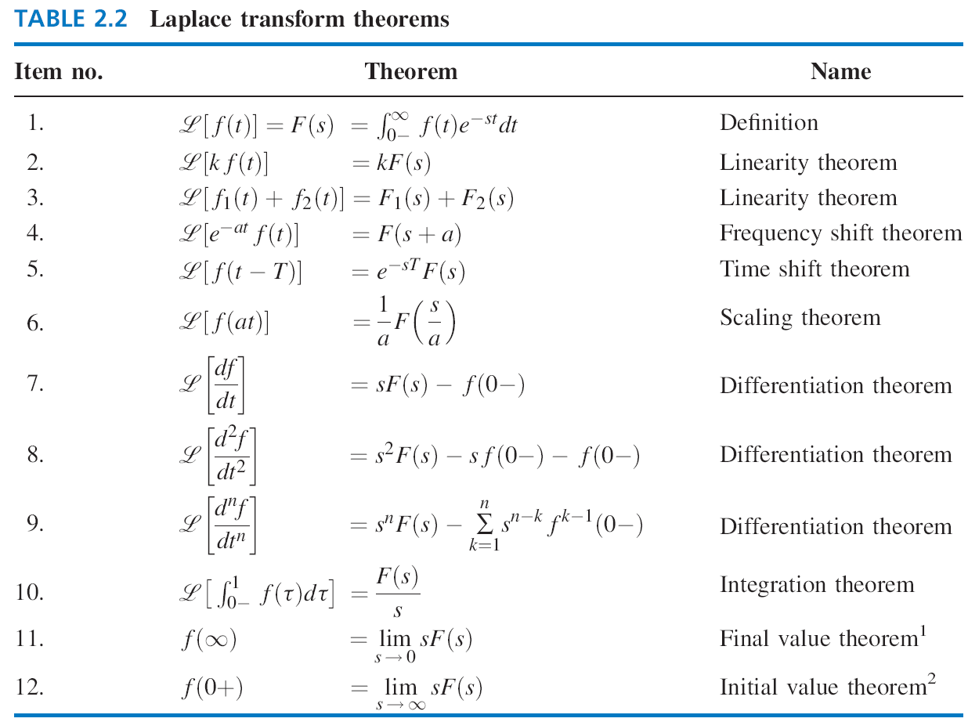
'
(END) Add Slides: Laplace’s Transform.

Slide 16
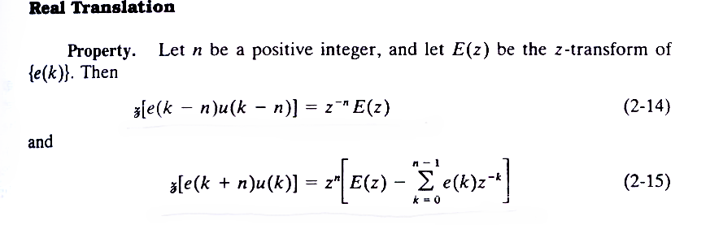
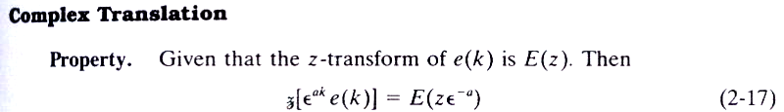
3)
Cf. Laplace’s Time Shift
Time delay
Initial
conditions
Lose values
→ Jump to the next two slides.
4)
Cf. Laplace’s Frequency Shift

Slide 17
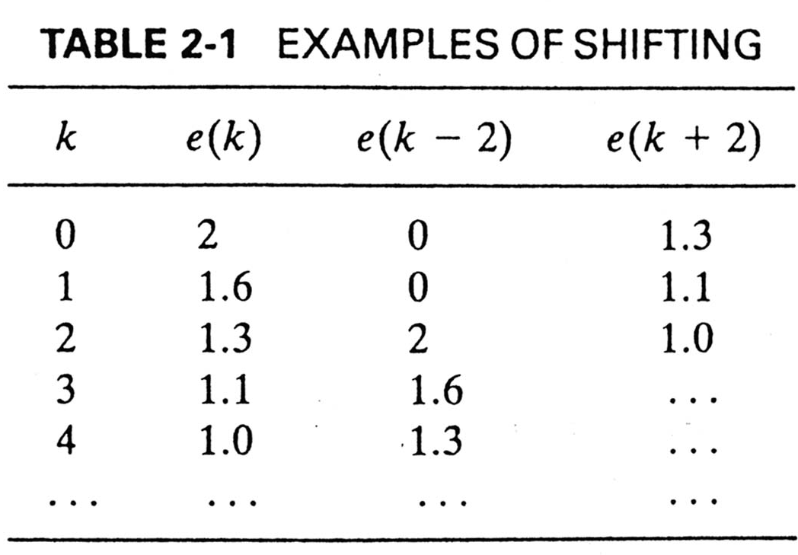
Real Translation (Time Shift)
Eq. (2-15): n=1, lose one values: e(0)
n=2, lose two values: e(0), e(1)

Slide 18
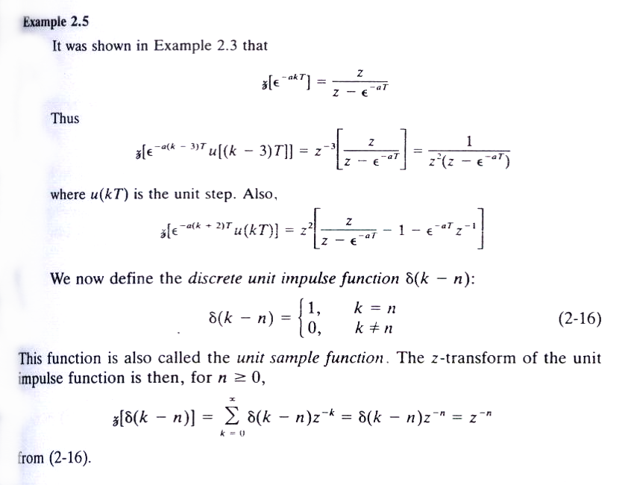
Example 2.5
Time delay
→ No loss
→ Lose two values
Add Slides: Dirac Delta Function.

Slide 19
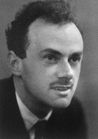
(START) Add Slides: Dirac Delta Function.
7.5 The Dirac Delta Function
Paul Adrian Maurice Dirac (1902-1984)
原子理論
Received the Nobel Prize in Physics, 1933.
“for the discovery of new productive forms of atomic theory.”
Notes:
Points to control
1. An Experiment, Outcomes, and the Sample Space
Definition. Experiment
Definition. Outcome of an experiment
Definition. Sample space for an experiment
2. Events
Definition. Events contained in a sample space
Examples
3. Some relations from Set Theory
Union of two events
Intersection of two events
Complement of an event
Disjoint events
Graphic device: Venn diagram

Slide 20
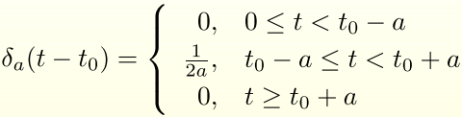

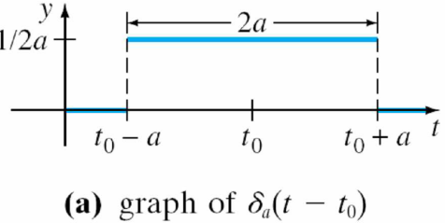
Unit Impulse
The function
is called a unit impulse, because it possesses the integration property:
Fig. 7.5.2

Slide 21
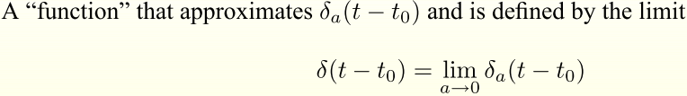
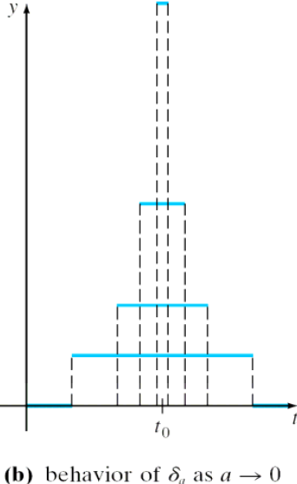


Dirac Delta Function
2 properties:
Fig. 7.5.2
(i)
(ii)
integration property

Slide 22
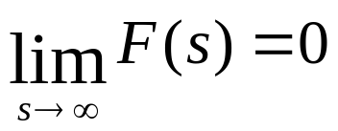
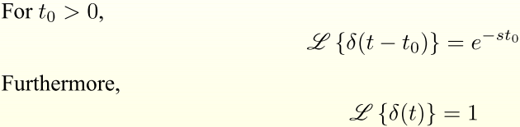
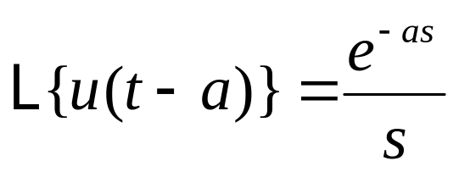
Recall from Thm. 7.1.3:
(P260, slide 13)
Thm 7.5.1 Transform of the Dirac Delta Function
Time delay
(as t₀=0)
Recall from 7.3.2 (P275, slide 35)

Slide 23
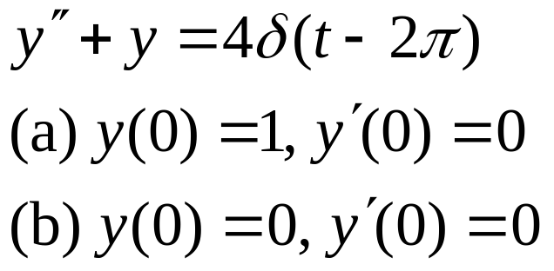
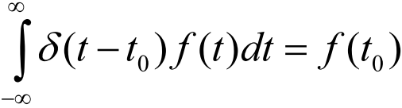

Ex-1: Two IVP Problems (Spring-Mass Systems)
See Remarks
Properties of Delta Functions
Integration
property
Sampling:
(definition)
Translation:
f(t) = 1
f(t) = e^{-st}
0
s-Transform
(END) Add Slides: Dirac Delta Function.

Slide 24
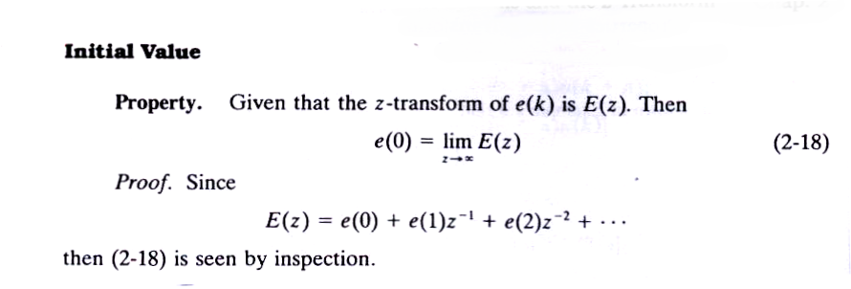
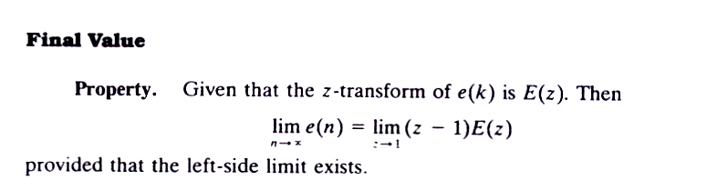
5)
6)
→ 求穩態值 → steady-state error

Slide 25
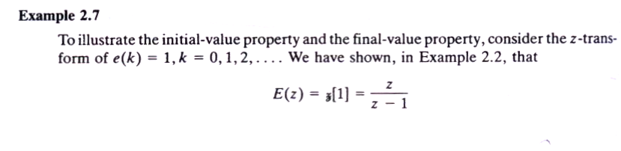
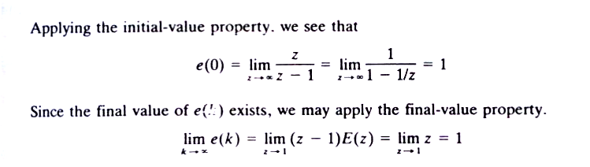
Example 2.7

Slide 26
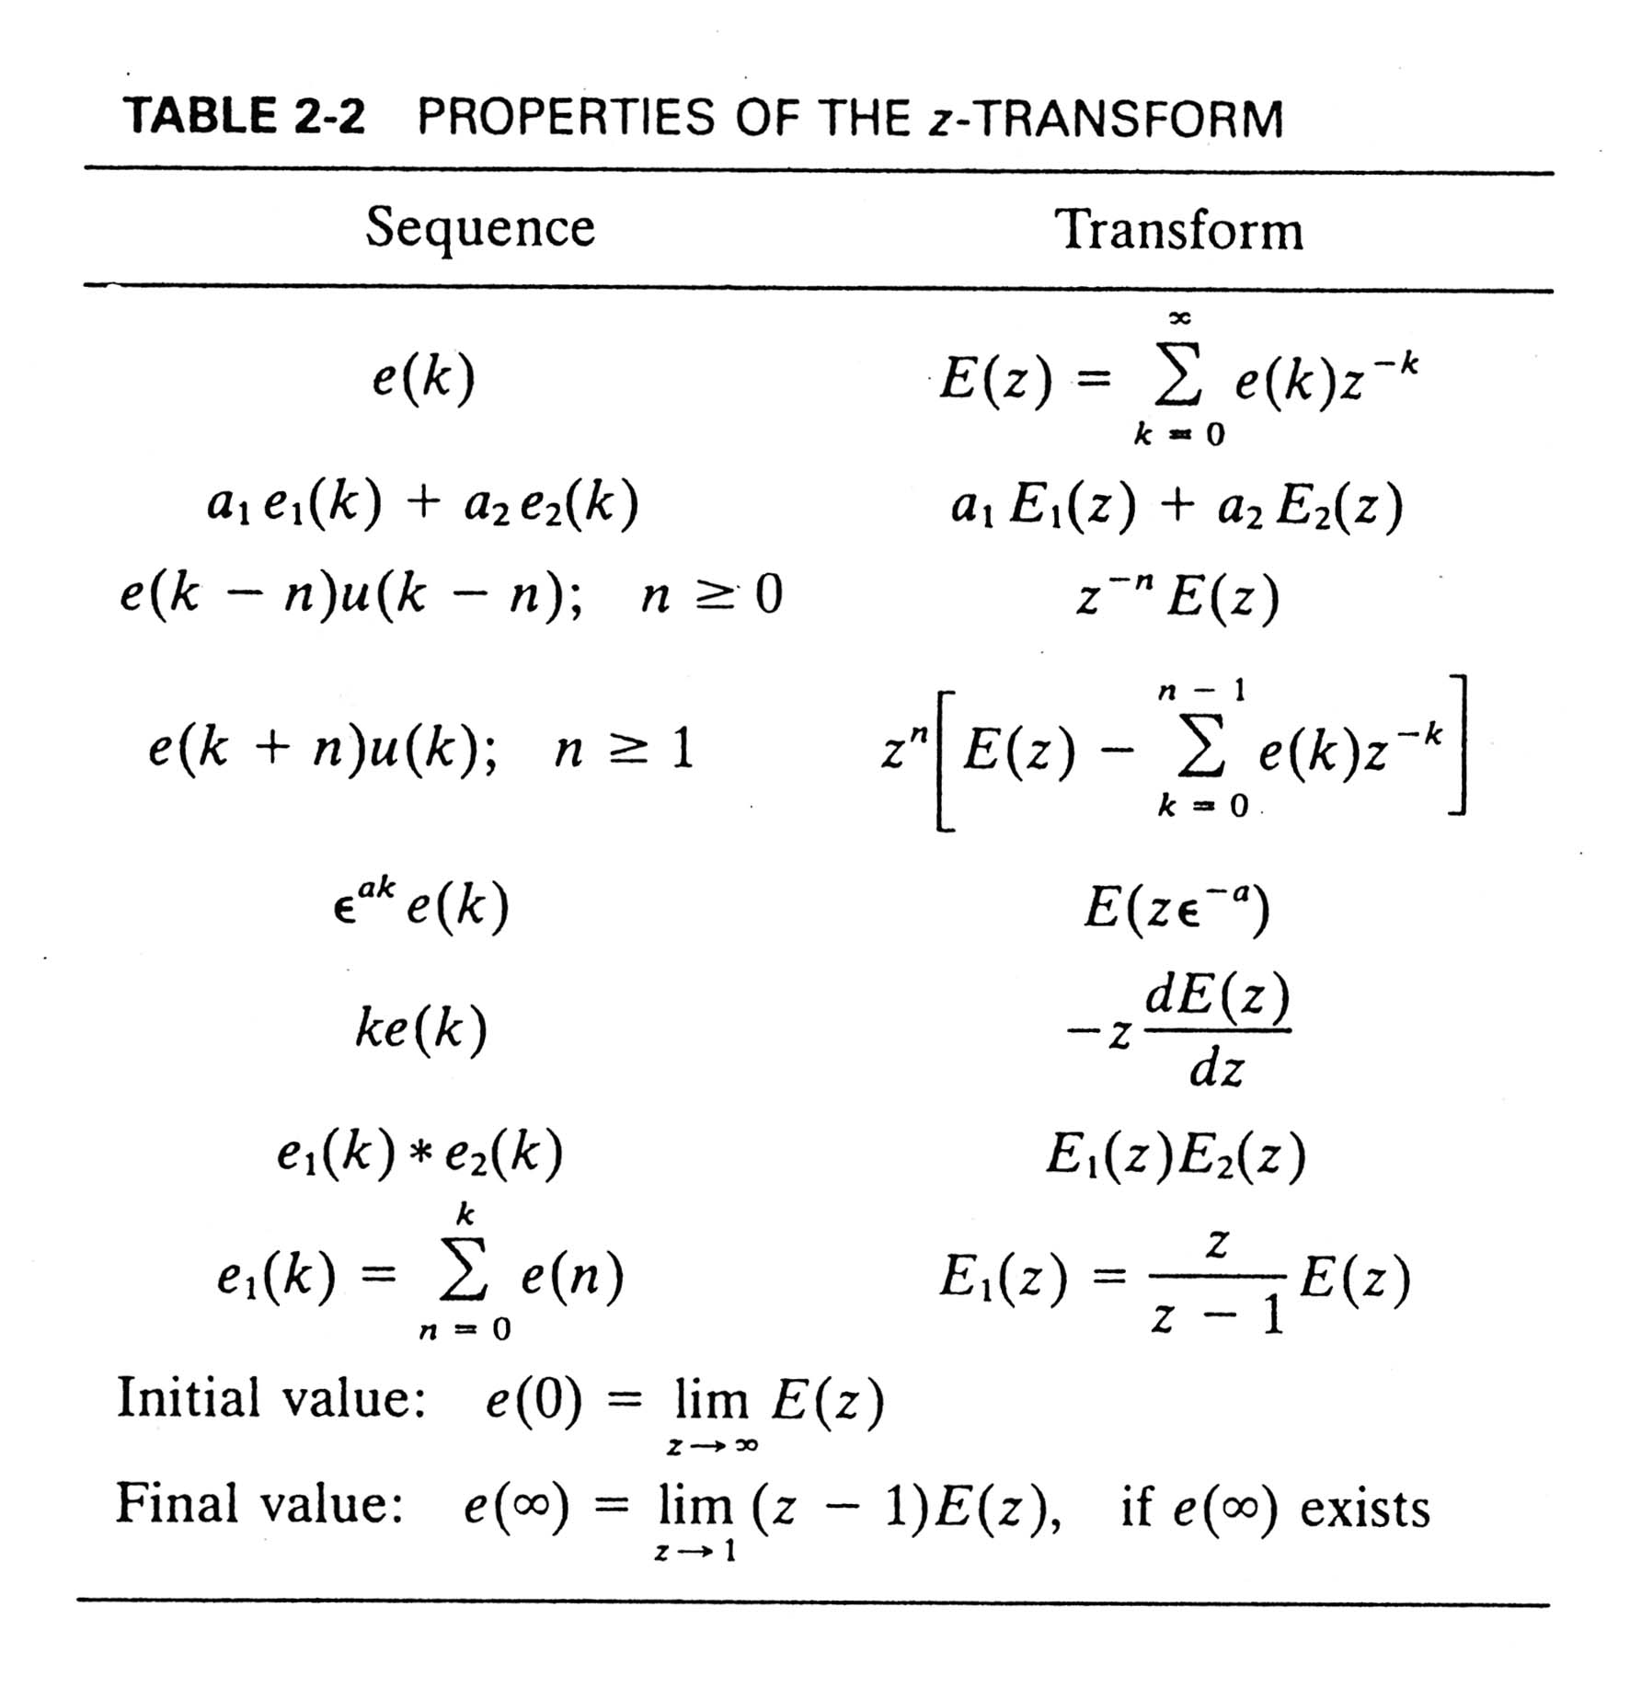
Linearity
Real
Trans.
Complex
Trans.
Convolution

Slide 27
2.5 Solution of Difference Equations
Three Approaches
1) Classical approach
    m = m_{c} (complementary: homo.) + m_{p} (particular)
2) Sequential procedure
    Digital-computer solution
3) z-transform

Slide 28
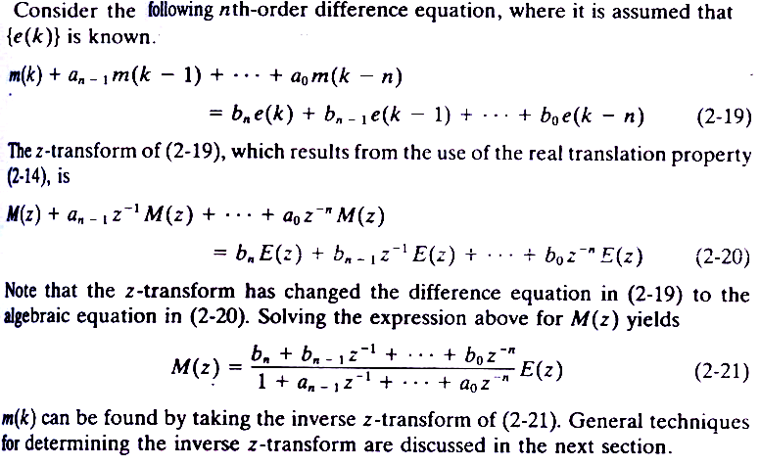
By z-Transform

Slide 29
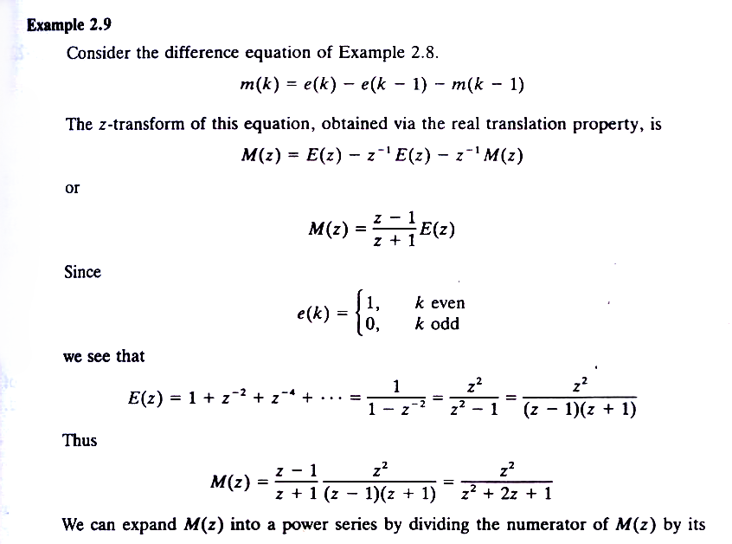
Example 2.9
From Example 2.8

Slide 30
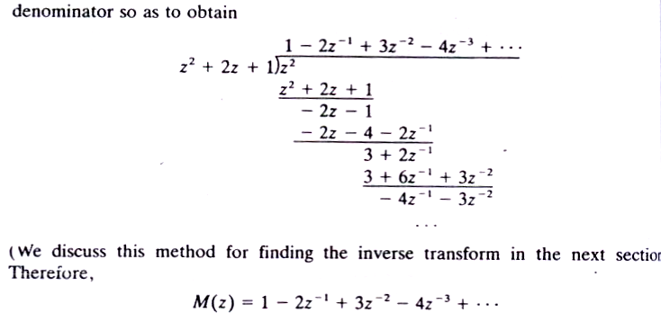
Power Series Method (Direct division)
m(k) => m(0)=1, m(1)=-2,
m(2)=3, m(3)=-4…
Solution in a closed form? Partial-Fraction Expansion Method. → Next
  m(k)= (-1)^{k}(1+k) (補充:p39)
Initial conditions of difference equations: k= [0, n-1] (see Tab. 2-2)
  Compare with differential equations: t = 0

Slide 31
2.6 The Inverse z-Transform
1) Power Series Method (Direct division)
2) Partial-Fraction Expansion Method
3) Inversion Formula Method (Inverse integral)
4) Discrete Convolution
Solution in an open form.
Solution in a closed form.
Solution in a closed form.
Solution in an open form.

Slide 32
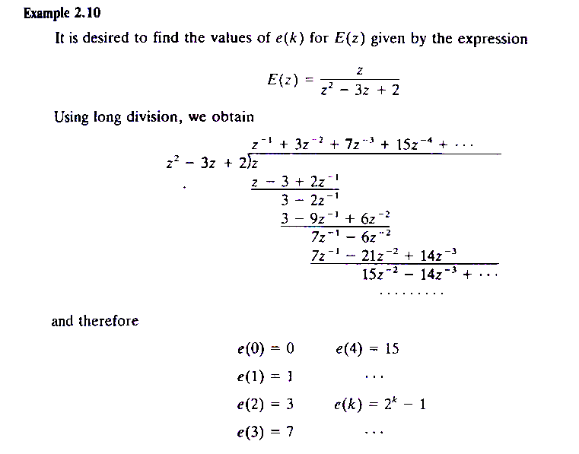
Example 2.10
Not easy to recognize the general expression.

Slide 33
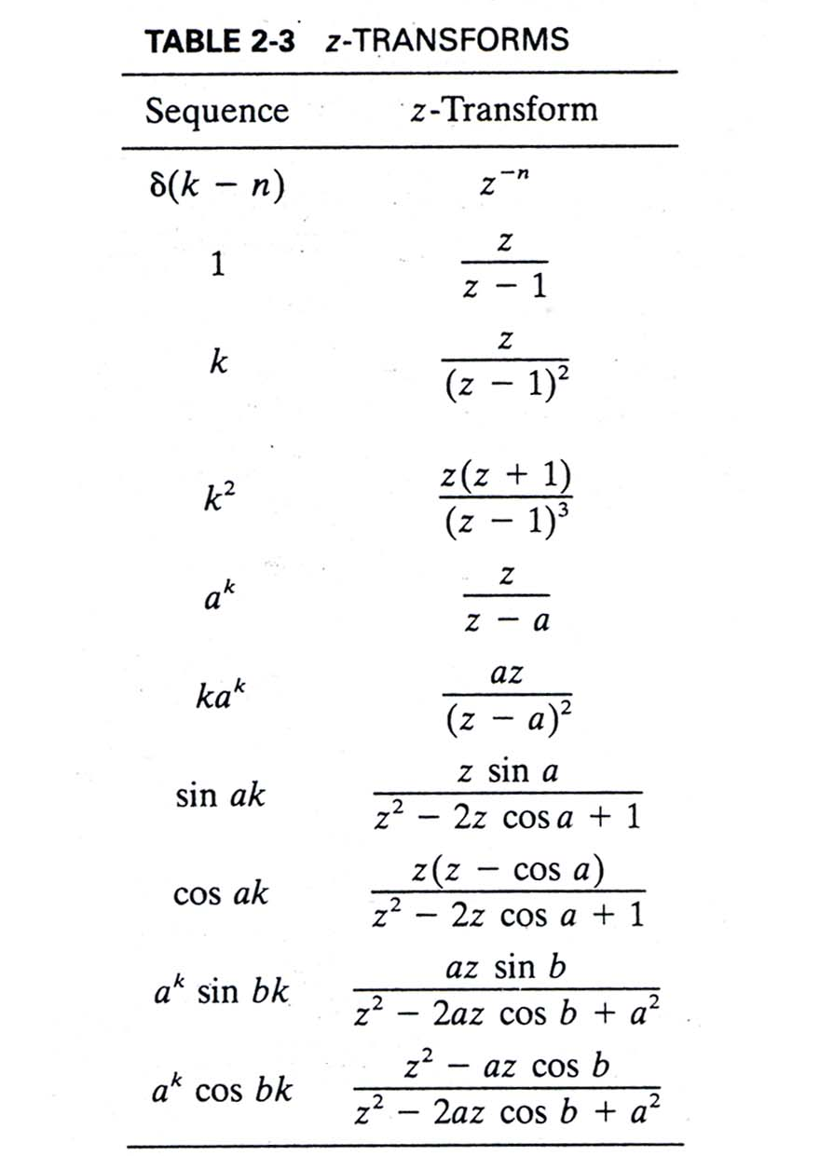
Partial-Fraction
Expansion Method
Special case: n=0
for 常數項
Pole = 1
Pole = a
Example 2.9
More: See Appendix VIII.

Slide 34
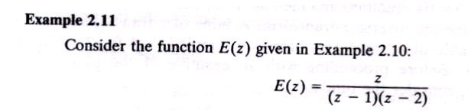
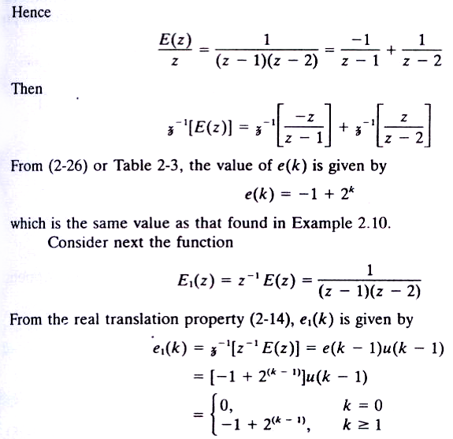
Real (distinct) Poles
方法-1
1

Slide 35
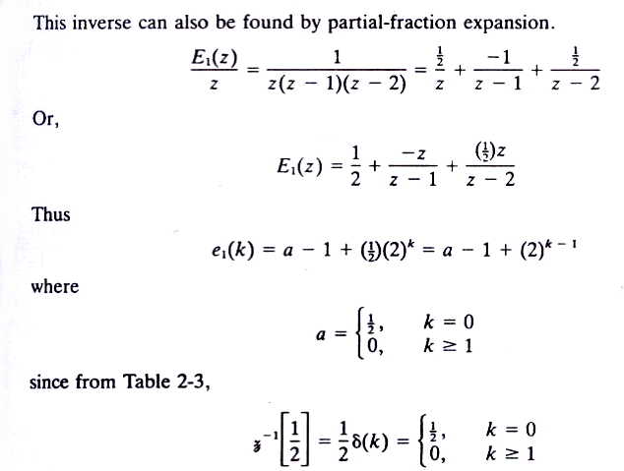
1
=
2
方法-2
2
Special case: n=0

Slide 36
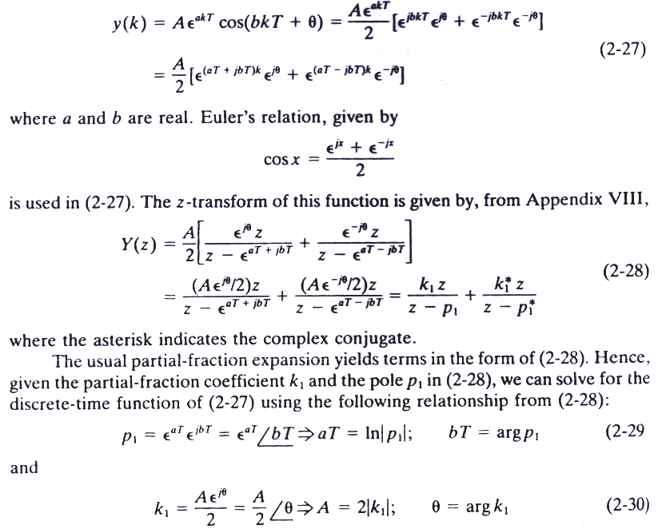
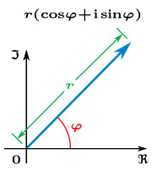
Complex Poles
solution
argument
coeffi.

Slide 37
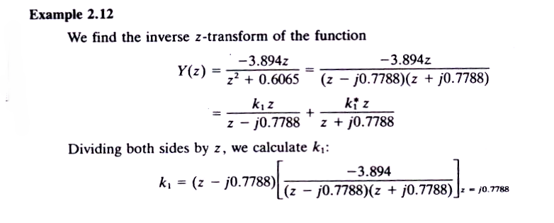
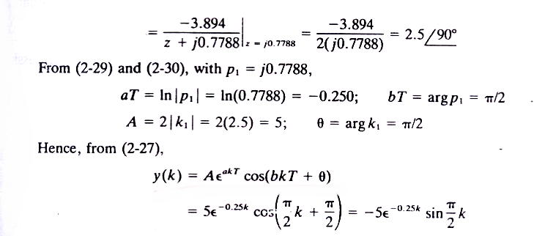
coeffi.

Slide 38
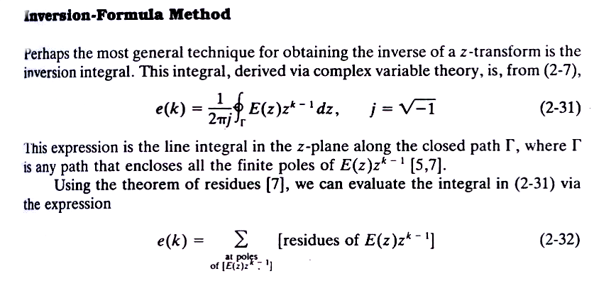

反轉公式
(2.33)
(2.34)

Slide 39

…left as an exercise.

Slide 40

離散迴旋
=

Slide 41



Slide 42

2.7 Simulation Diagrams & Flow Graphs
System Modeling
  Diff. Equations
  Transfer Functions
  State Space
  Diagrams: Block diagrams, Signal flow charts
Symbolic
representation

Slide 43



1st-order DE
(2.40)
input
output
Special-purpose vs.
general purpose computers (Ex. 2.8)
Minimal representation (n delays only)
This representation may be verified via Mason’s gain formula.

Slide 44

Basic Elements
Continuous systems: integrator.
Discrete systems: time delay (memory) of T sec.

Slide 45

Mason’s gain formula: App. II (page 626)

Slide 46

SIGNAL-FLOW GRAPHS
(START) Add Slides: Signal-Flow Graphs and Mason’s rule.
Each signal is the sum of signals flowing into it.
Branch
System
Node
Signal

Slide 47


MASON’S RULE
DEFINITIONS
Loop gain

Slide 48


Forward-path gain
Nontouching loops: G₂(s)H₁(s) does not touch other three loops.
Nontouching-loop gain (taken two at a time)
MASON’S RULE

Slide 49

EXAMPLE 5.7

Slide 50

EXAMPLE 5.7
T₁

Slide 51

EXAMPLE 5.7

Slide 52


EXAMPLE 5.7
More: Check the “feedback control form”.
(END) Add Slides: Signal-Flow Graphs and Mason’s rule.

Slide 53


nth-order DE
(2.43)
Simulation diagram (non-minimal representation: 2n delays)

Slide 54


Slide 55

2.8 State Variables

Slide 56






(2.45-46)
If the system is linear
(2.47-48)
If the system is time invariant
D: Feedforward matrix
(2.49-50)

Slide 57


補充: SFG (p.55)
phase variable
相位變數標準型
Phase variable canonical form / control canonical form

Slide 58




Given the transfer function
(2.51)
Write as
(2.52)
let
sin(ωt) vs. cos(ωt) 相位
(2.53-54)
Phase variables
Define the state variables
Obtain the state equation
(2.55)
(2.56)

Slide 59




In matrix form is
About b_{n} in (2.43), see Slide 66.
(2.57, 59)
State Equations
or simply
(2.58, 60)

Slide 60

Signal Flow Graph Representation
The form can be derived as
(2.61)
(2.62-63)
Can be written as
(2.64)

Slide 61

Signal Flow Graph Representation
Y (z): see (2.62)
(2.51)
E (z): see (2.64)

Slide 62

Simulation Diagram
(2.51)
Control Canonical Form:
Use in the design of controller.

Slide 63

Observer Canonical Form:
Use in the design of observer.

Slide 64

(2.51)
Phase variables
Control Canonical Form:
Use in the design of controller.

Slide 65


Slide 66

The same order (num. & denom.)
b_{n} is not zero!
(2.43)

Slide 67

Feedforward
control
D= b₂
y(k)
u(k)

Slide 68

D: Feedforward matrix

Slide 69

Example 2.19
2 inputs
2 Approaches:
1) TF → SS: use Eq. (2-52)~(2-59)
2) TF → diagrams → SS

Slide 70
Approach 2
Procedure to Obtain State Models
Draw a block diagram or signal flow chart.
Assign a state variable to each delay output, x(k).
Write the equation for each delay input, x(k+1), and each system output, y(k), in terms of only the delay outputs, x(k), and the system input, u(k).

Slide 71


2.9 Other State-Variable Formulations
Cascade

Slide 72

Parallel
Different SS models
Phase variable (Ex. 2.16)
Cascade (Ex. 2.20)
Parallel (Ex. 2.20)
Diagonal (Ex. 2.22)
Any More… (Ex. 2.21)

Slide 73








Similarity Transformations
Consider the state equation
(2.67)
Apply the linear transformation
(2.68)
yield
(2.69)
These equations can be expressed
(2.70)
Where
(2.71)

Slide 74




The characteristic equation is defined by
(2.72)
(2.73)
and
(2.74)
Similarity transformation has the following properties
Trace (跡): see P639.
Unique TF

Slide 75

Cofactor (餘因子): See P640.

Slide 76


Slide 77


Modal Matrix
形式矩陣

Slide 79


Slide 80


Slide 81
2.10 Transfer Functions
Two Approaches to obtain TF via SS
  SS → Diagrams → TF (by Mason’s rule)
  SS → TF (by z-Transform)

Slide 82



Approach 1

Slide 83







SS → TF (by z-Transform)
Eliminate X(z)
Another approach for obtaining the system transfer function from the state equations
(2.78)
Taking the z-transform yields
(2.79)
Ref P37.
Ignore initial conditions
(2.80)
(2.81)
also
(2.82)
Taking the z-transform yields
(2.83)
The system transfer function is
(2.84)

Slide 84

Approach 2

Slide 85








2.11 Solutions of The State Equations
1) Recursive solution
The system equation
(2.86-87)
that
hence
similarly
Then, the general solution is given by
(2.88)
If we define
State transition/fundamental matrix
狀態轉移/基本矩陣
(2.89-90)

Slide 86



Slide 87






2) z-transform Method
The general solution to the state equation
(2.91)
Let
Then the z-transform of this equation yields
(2.93)
(2.94)
Then take z-inverse
(2.95)
Compared with
(2.89)
(2.96)
Recall:

Slide 88


Slide 89




2.12 Linear Time-Varying Systems
(2.104-105)
k₀: Initial time
(2.106)
(2.107)

Slide 90
See Summary (P77)
Problems: 2-1, 2-3, 2-6, 2-7, 2-8
2-10, 2-23, 2-26
Test Bank

